Slide 1
AI in
Brain Tumor Diagnosis
Classification and care
Under Supervision Of :
Prof . Marwa Reda
Noura Shousha | Esraa Alaa | Manal Anwer
Mohamed El-Gazar | Mahmoud El-Gendy
Mohamed Abd El-Shafy | Ahmed Gebreel
Abd El-Rahman Al-Asfar

Slide 2
TABLE OF CONTENTS
01
02
03
04
05
INTRODUCTION
PROBLEM
SOLUTION
RESULTS
CONCLUSIONS

Slide 3
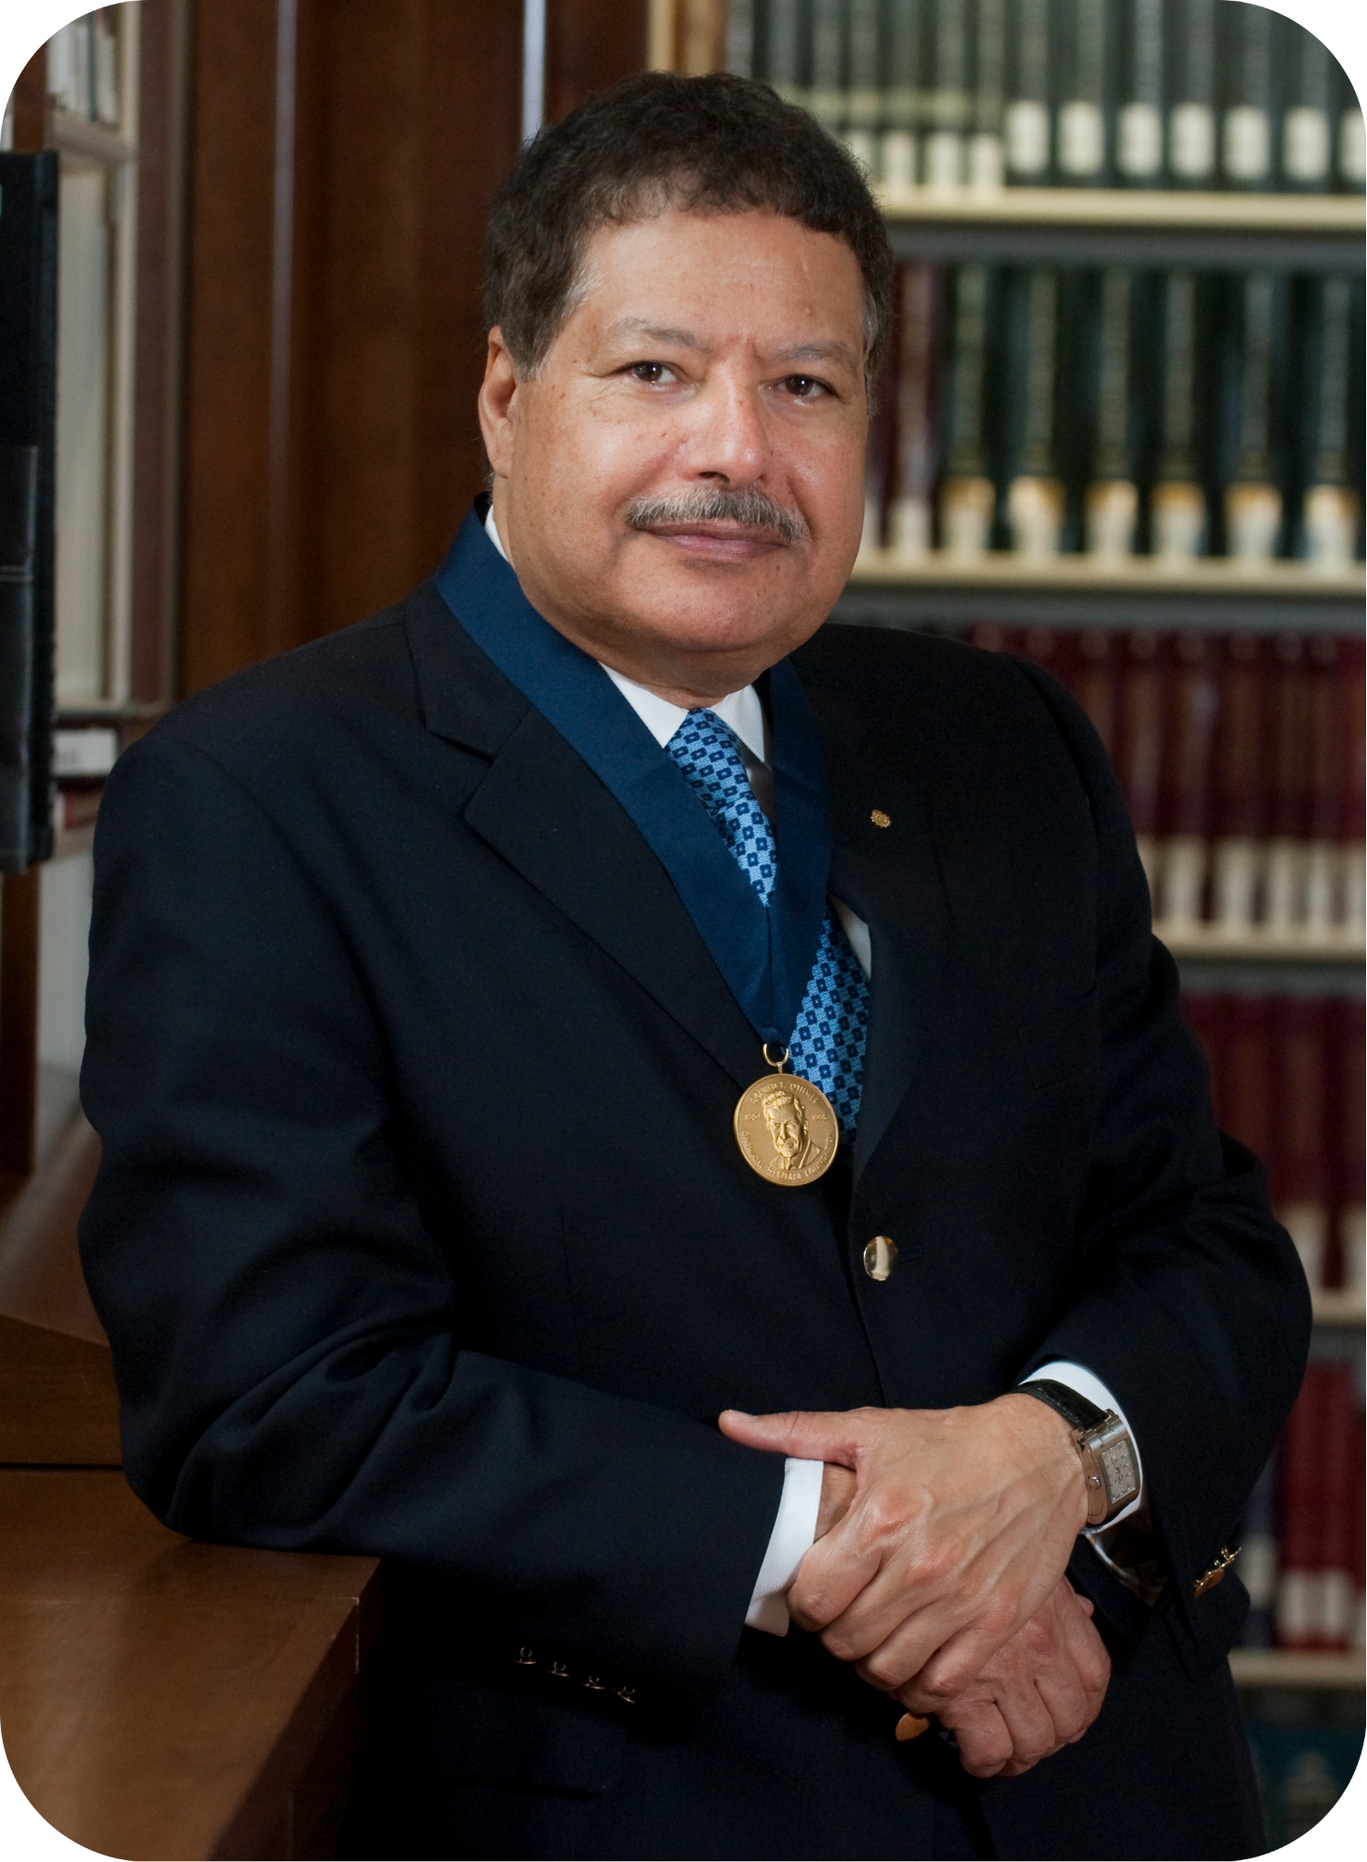
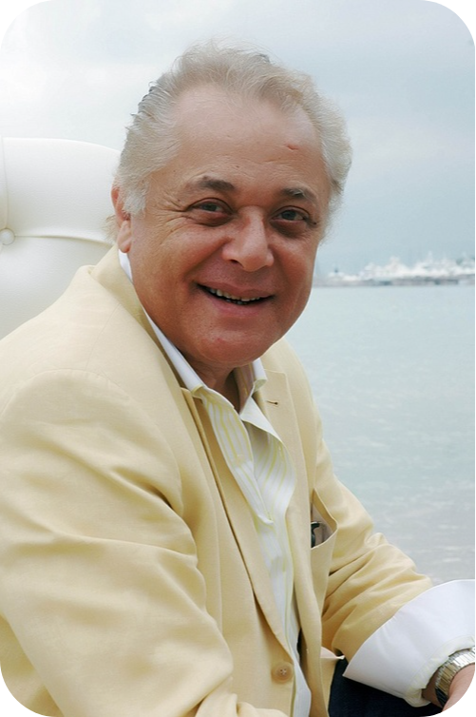
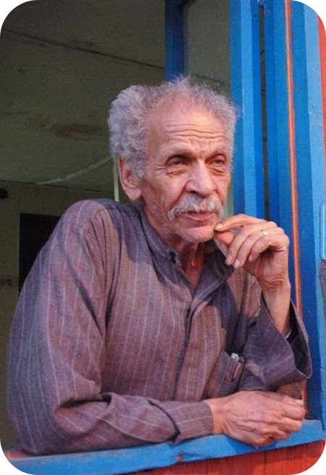

Slide 4
PROBLEM

Slide 5
1M Affected
90,000 New/Y
19,000
Death/Y
EUROPE
21.8%
ASIA
52.26%
NORTH AMERICA
8740
Egy-2025
9.1%
AFRICA
5.7%
LATIN AMERICA
10%
American brain tumor association :https://www.abta.org
National cancer institutions: https://seer.cancer.gov
National library of medicine: https://www.ncbi.nlm.nih.gov/pmc/articles/PMC4189936/
Notes:
16,888
egy2050

Slide 6
Early Detected
Late Detected
Can survive up t0
20 years
Can survive up t0
5 years

Slide 7
SOLUTION

Slide 8
OUR WORK
FOR EXPERTS:
FOR PATIENTS:
DETECTION
AND
CLASSIFICATION
MEDICAL CHATBOT

Slide 9
DETECTION
AND CLASSIFICATION
01

Slide 10
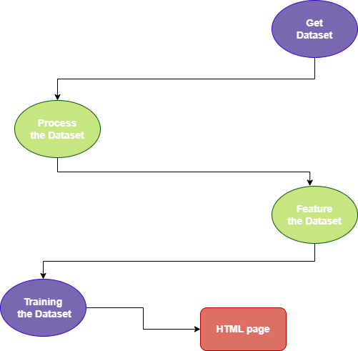
Training:
Data Collection
Data processing
Feature Extraction
Model Selection
Model Training
Model Evaluation
Model Testing
Fine-Tuning and Optimization

Slide 11
WE USED:
Some of the most important python libraries were used, such as:
Os
Requests
Flask
·
Pandas
Scipy
Matplotlib
PIL
TF
Pytorch
Numpy
Werkzeug libraries

Slide 12
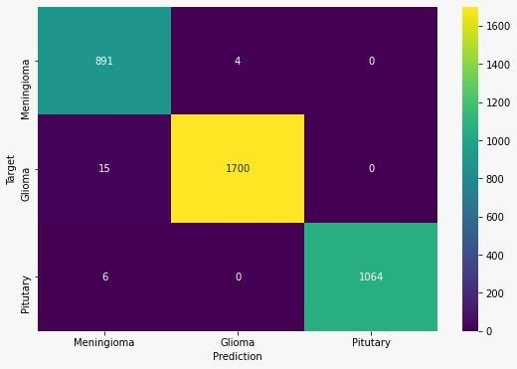
RESNET-50 MODEL
Heatmap of Confusion Matrix:

Slide 13
TENSORFLOW MODEL
Classification Report
 | precision | recall | f1-score | support
meningioma_tumor | 0.98 | 0.96 | 0.97 | 93
no_tumor | 0.96 | 1.00 | 0.98 | 51
pituitary_tumor | 0.98 | 0.98 | 0.98 | 96
glioma | 1.00 | 1.00 | 1.00 | 87
accuracy | - | - | 0.98 | 327
Macro avg | 0.98 | 0.98 | 0.98 | 327
Weighted avg | 0.98 | 0.98 | 0.98 | 327

Slide 14
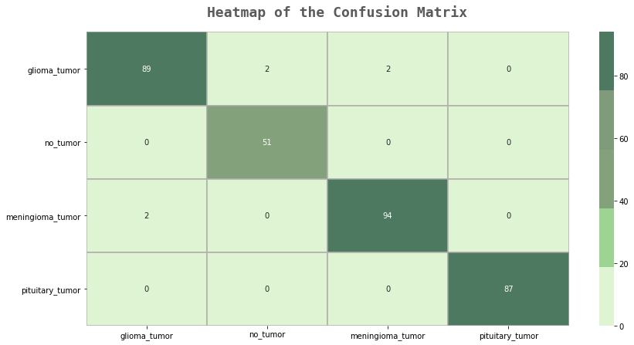
Heatmap of Confusion Matrix

Slide 15
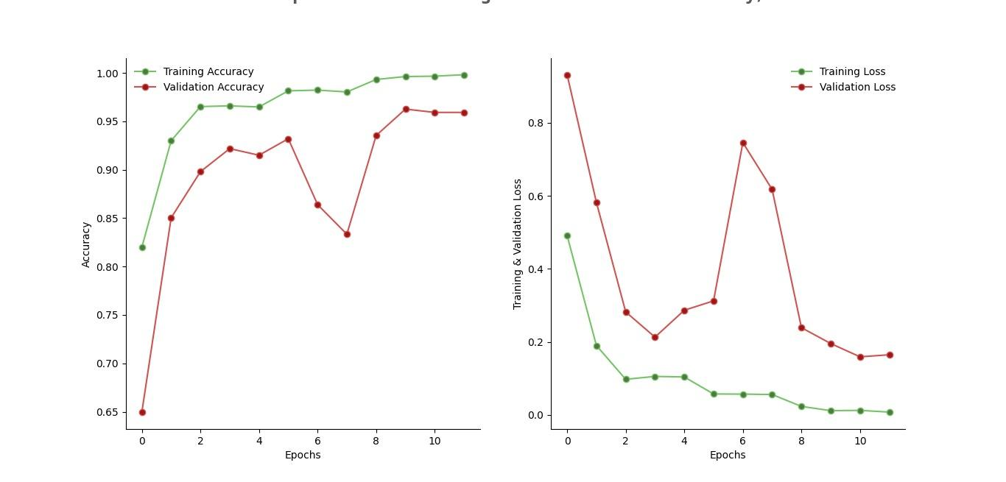
Training VS Validation Performance

Slide 16
KAN MODEL
Classification Report
 | precision | recall | f1-score | support
meningioma_tumor | 0.70 | 0.97 | 0.81 | 115
no_tumor | 0.72 | 1.00 | 0.84 | 105
pituitary_tumor | 0.88 | 0.89 | 0.89 | 74
glioma | 1.00 | 0.13 | 0.23 | 100
accuracy | - | - | 0.75 | 394
Macro avg | 0.82 | 0.75 | 0.69 | 394
Weighted avg | 0.82 | 0.75 | 0.69 | 394

Slide 17
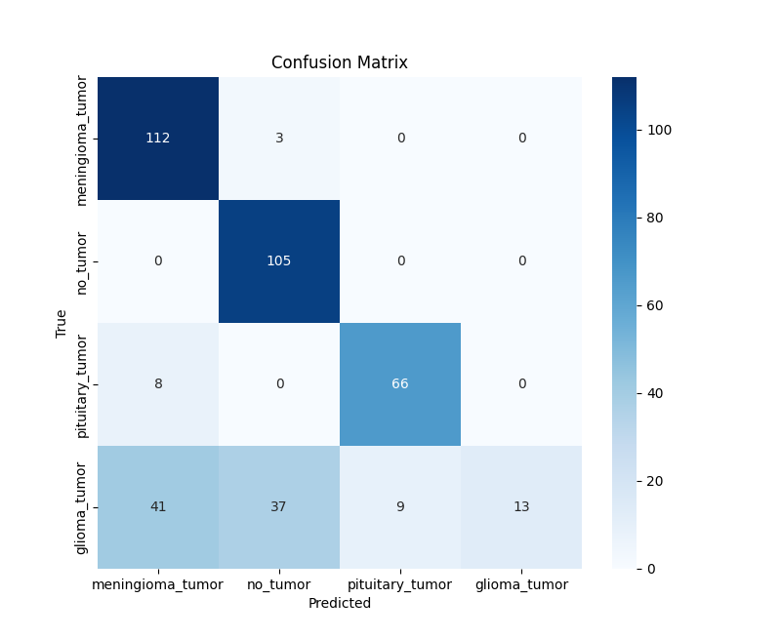
Heatmap of Confusion Matrix

Slide 18
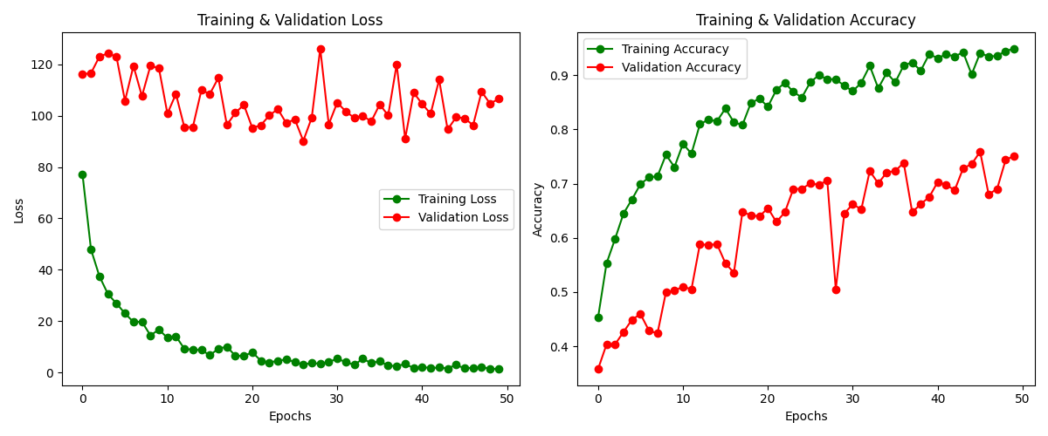
Training VS Validation Performance

Slide 19
02
MEDICAL CHATBOT

Slide 20
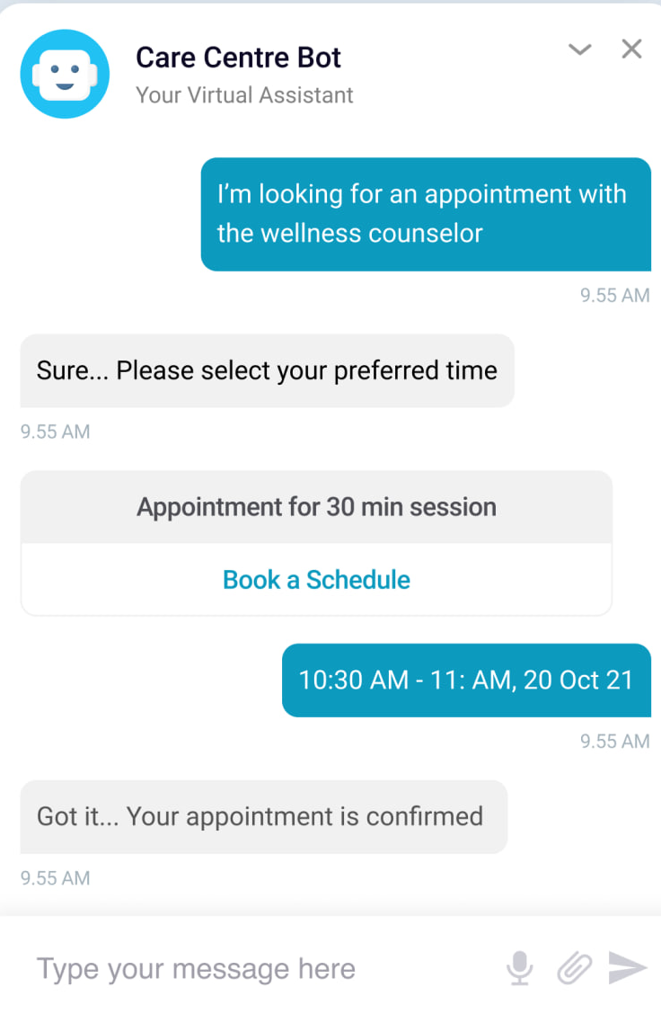
What is a Medical chatbot?
Is a conversational AI-powered solution
Designed to make healthcare more interactive and proactive.
Chatbots were used also for firsthand symptom assessment.
Healthcare chatbots act as the mediator between patients and their healthcare providers.

Slide 21
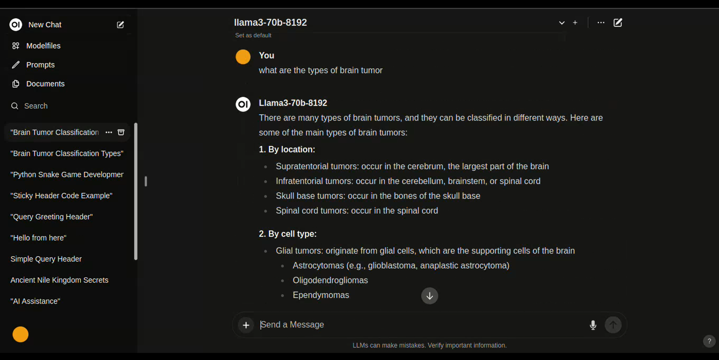
Our medical chatbot:

Slide 22
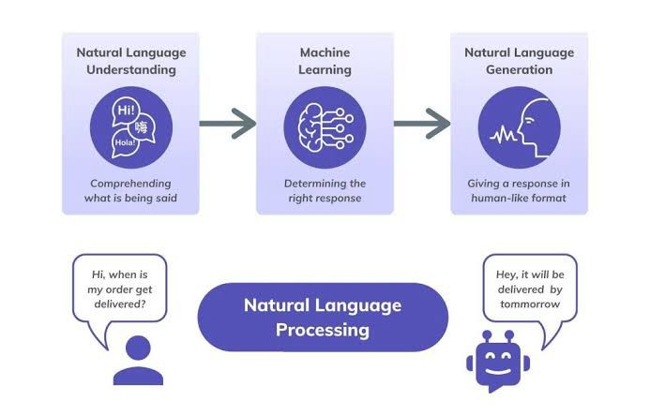
The relationship between NLP and CHATBOT:
Understanding User Input
Sentiment Analysis
Language Translation
Context Management
Information Retrieval
Named Entity Recognition

Slide 23
WE USED:
Some of the most important models and apps were used, such as:
Ollama
Docker
Meta
Open WebUI

Slide 24
Results

Slide 25
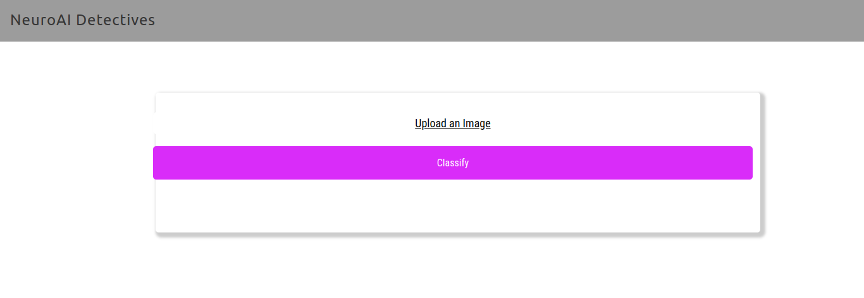
Classification Output
Index page
where the test image can be provided

Slide 26
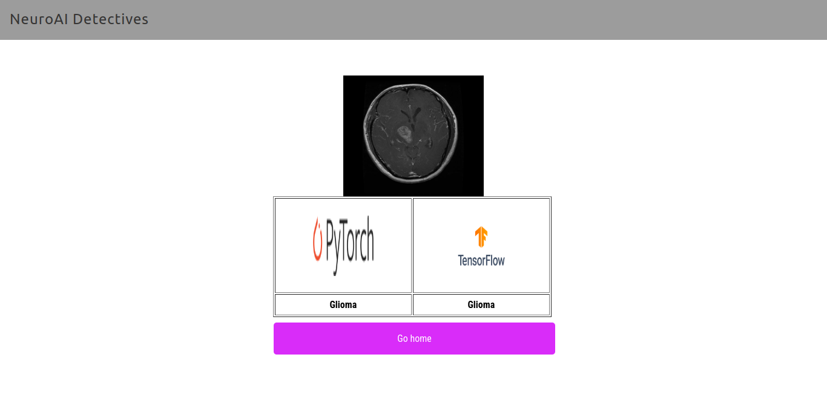
This is how the pred page is displayed
( in this case it’s Glioma, there are more types to classify )

Slide 27
Conclusion

Slide 28
How exactly is this project helpful?
Assisting healthcare professionals ,by:
Enhancing their decision
Speeding the classification process
Decreasing human-error occurrence

Slide 29
2) Improved accessibility
3) Cost-Efficiency
4) Early Detection
5) Patients after-care using Medical Chatbot

Slide 30
THANKS!

